Slide 1
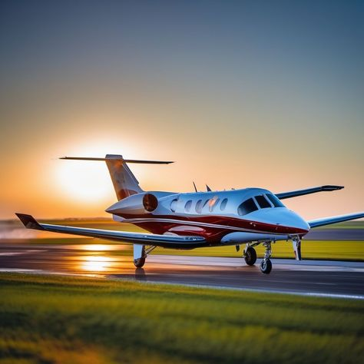

Operations project – 1st Term
NAME – AYUSHI SHARMA
ROLL NO. – 021330024091
ITEM ALLOTED - AIRCRAFT

Slide 2


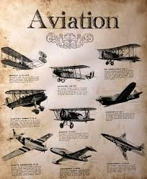
Introduction and History of Aircraft
Aircraft, powered heavier-than-air machines capable of flight, have a rich history spanning over a century. The dream of human flight has captivated minds since antiquity, but it wasn't until the late 19th and early 20th centuries that technological advancements allowed for the creation of practical flying machines. The Wright brothers' first successful flight in 1903 marked a pivotal moment, laying the foundation for the modern aviation industry.
by Ayushi Sharma

Slide 3
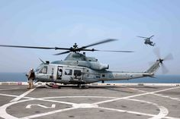
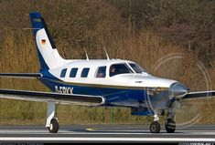
Types of Aircraft
Fixed-Wing Aircraft
Rotary-Wing Aircraft
Other Aircraft
Characterized by wings that remain fixed during flight. This category includes airplanes, gliders, and seaplanes.
Utilize rotating blades for lift and propulsion. Helicopters are the most common type of rotary-wing aircraft, known for their ability to hover and take off vertically.
Includes airship, blimp, and drone. Airships use buoyant gases for lift and are known for their long endurance. Blimps are a type of airship with a rigid frame. Drones are unmanned aircraft controlled remotely.
Commercial airliners
Private jets
Military helicopters
Fighter jets
Civil helicopters
Remotely piloted aircraft (RPA)
Cargo planes
Tiltrotor aircraft
Unmanned aerial vehicles (UAV)

Slide 4

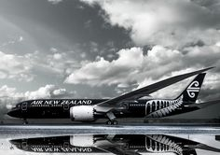
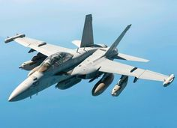
Raw Materials Used to Manufacture Aircraft
1
Aluminum
2
Titanium
Lightweight and strong, making it ideal for aircraft structures.
Highly resistant to corrosion and heat, used for critical components like engine parts.
3
Composite Materials
4
Carbon Fiber
Lightweight and durable, often used for wings, fuselages, and control surfaces.
Strong and lightweight, increasingly used for aircraft structures, reducing weight and improving fuel efficiency.

Slide 5


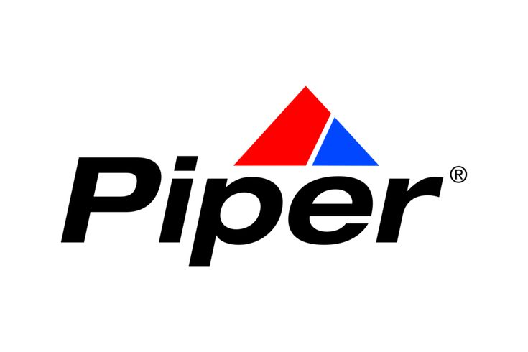


Global Aircraft Brands
Boeing
Airbus
Embraer
Bombardier
Lockheed Martin
Northrop Grumman
Raytheon
General Dynamics
Dassault Aviation
Sukhoi
Mitsubishi Heavy Industries
Comac

Slide 6

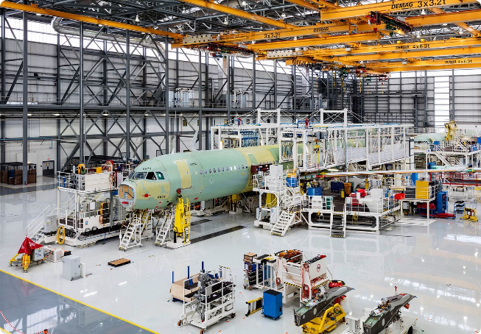




Tools and Equipment Required for Aircraft Manufacturing
Machining Tools
Welding Equipment
Used to shape and cut metal parts, including lathes, milling machines, and drilling machines.
Essential for joining metal parts together, including arc welding, gas welding, and laser welding.
Heavy Lifting Equipment
Robotics
Cranes, hoists, and forklifts are crucial for moving and assembling large aircraft components.
Robots play a growing role in aircraft manufacturing, automating tasks and improving accuracy.

Slide 7


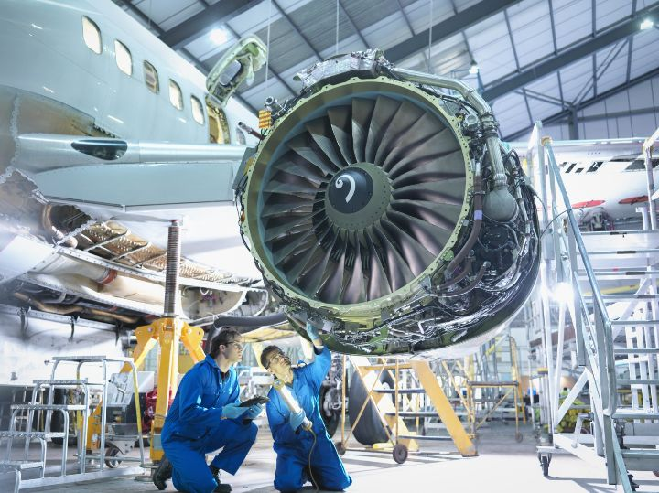




Aircraft Transformation Process
Design and Engineering
The process begins with detailed design plans and engineering calculations.
Material Procurement
Raw materials are sourced and delivered to the manufacturing facility.
Component Manufacturing
Individual parts, such as wings, fuselage sections, and engine components, are fabricated.
Assembly
Components are assembled into a complete aircraft, with specialized tools and equipment.
Testing and Certification
The aircraft undergoes rigorous testing to ensure safety and compliance with regulations.
Delivery
Once certified, the aircraft is delivered to the customer, ready for operation.

Slide 8


Finished Aircraft Product
Aerodynamic Performance
Safety Features
Modern aircraft incorporate advanced safety features, including redundant systems and emergency procedures.
Aircraft are designed for efficient flight, with smooth contours and optimized wing shapes.
Passenger Comfort
Environmental Considerations
Commercial airliners provide comfortable seating, in-flight entertainment, and amenities.
Aircraft manufacturers strive to reduce noise pollution and fuel consumption, promoting sustainability.

Slide 9
Packaging, Warehousing, Handling, Transportation, and Inventory Management
Packaging
1
Aircraft are carefully packaged to protect them during transportation and storage.
2
Warehousing
Specialized facilities are required to store aircraft, ensuring proper environmental conditions.
Handling
3
Specialized equipment and trained personnel are essential for safely handling and moving aircraft.
4
Transportation
Aircraft are typically transported by air or sea, requiring specialized transportation methods.
Inventory Management
5
Effective inventory management is crucial to ensure timely delivery of aircraft and spare parts.

Slide 10
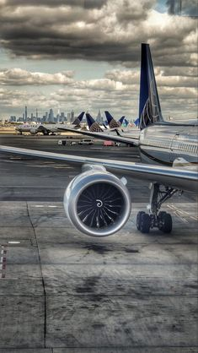
.. THANK YOU

